Slide 1
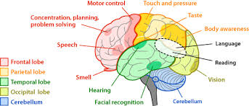
The Brain

Slide 2
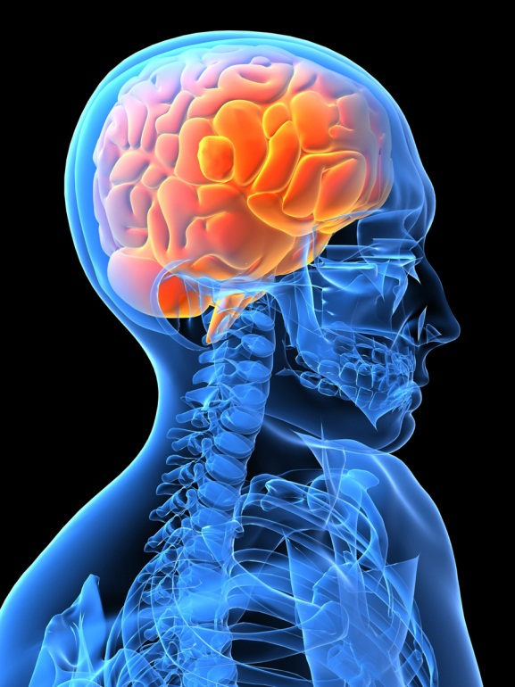

3 Memory Storage Systems
Sensory
Short Term
Long Term

Slide 3
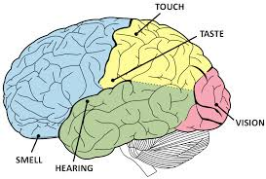
Sensory Brain
Notes:
What do you think of when you feel something soft like fleece?
What do you think of when you see a picture of you when your were young?
What do you think of when you smell cinnamon?
What do you think of when you hear your favorite song?

Slide 4

Touch
Put your hand inside the bag and tell me what it feels like.
Notes:
Have students put their hand in a bag and guess what they are touching?

Slide 5
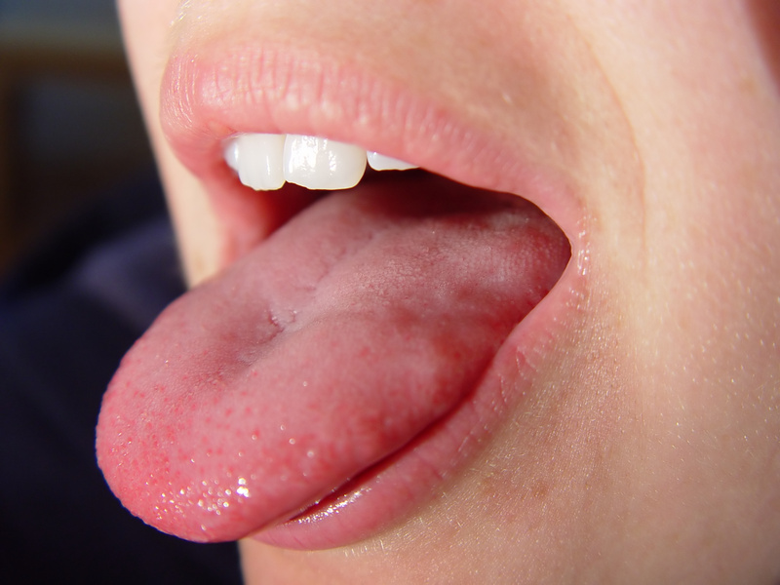
Taste
Notes:
Ask for volunteers to taste test? Place a piece of food on their tounge and have them describe what it taste like.

Slide 6
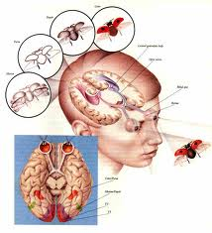
Vision trumps all other senses.
Notes:
Hold up flash cards/pictures and words to test memory retention

Slide 7
Hearing
Listen to the music and raise your hand if you can tell me the name of the song.

Slide 8

Smell
Raise your hand of you want to smell what is in the bag.

Slide 9
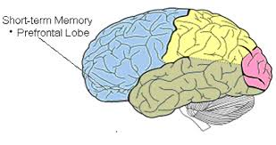
Short Term Memory (STM)
Notes:
Also known as the working memory.

Slide 10
STM – Three kinds of Operations
Iconic – holds visual images
Acoustic – holds sounds
Working – active process to keep information until it is put to use

Slide 11
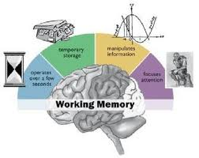
Working Memory occurs during STM

Slide 12

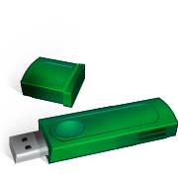

Chunking – 7 bits of info.
Brain
Memory
Storage
Short -Term
Working
Repetition
Long - Term

Slide 13
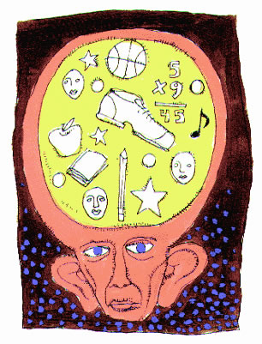
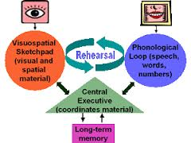
Long Term Memory (LTM)

Slide 14
LTM – Four Types
Declarative –
  Semantic - facts, principles, rules: problem solving strategies
  Episodic – personal experiences
Procedural – tie your shoes, ride a bike, drive a car
Imagery – pictures
Concept – set of rules by which we group similar events, ideas or objects

Slide 15

Personal Connection

Slide 16
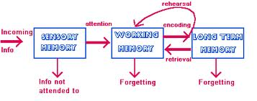
3 Memory Storage Systems

Slide 17
Using the Information Processing Approach in the Classroom
Principle | Example
1. Gain students attention | Use cues to signal when you are ready to begin. Move around the room and use voice inflections.
2. Bring to mind relevant prior learning | Review previous day’s lesson. Have a discussion about previously covered content.
3. Point out important information. | Provide handouts. Write on the board.
4. Present information in an organized manner. | Show a logical sequence to concepts and skills. Go from simple to complex.
5. Show students how to categorize (chunk) information. | Present information in categories. Teach inductive reasoning.

Slide 18
Using the Information Processing Approach in the Classroom
Principle | Example
6. Provide opportunities for students to elaborate on new information. | Connect new information to something already known. Look for similarities and differences among concepts.
7. Show students how to use coding when memorizing lists. | Make up silly sentence with first letter of each word in the list. Use mental imagery techniques such as the keyword method.
8. Provide for repetition of learning. | State important principles several times in different ways (STM) Have items on each day’s lesson from previous lesson (LTM) Schedule periodic reviews of previously learned concepts and skills (LTM).
9. Provide opportunities for overlearning of fundamental concepts of skills. | Use daily drills fro arithmetic facts Play form of trivial pursuit with content related to class.

Slide 19
What affects how we use our brains?

Slide 20
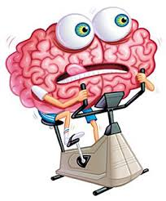
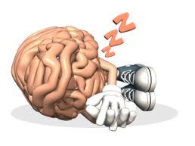
What affects our brain?
Exercise
Sleep

Slide 21
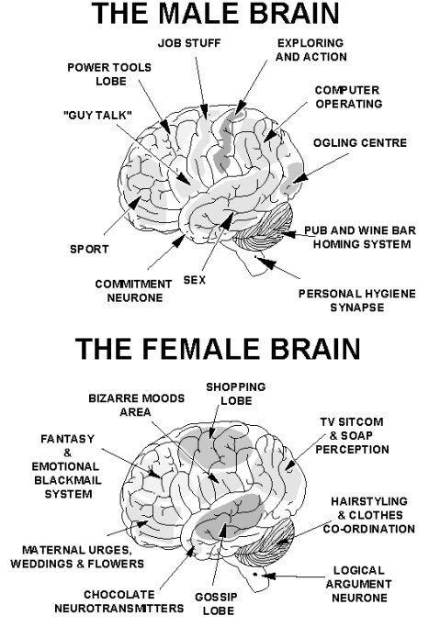

What affects our brain?
Gender
Stress

Slide 22
The End

